Slide 1


Automated test

Slide 2
Car diagnose computer

Slide 3
Car diagnose computer
Car has to be build to be tested
Each test will tell of a potential error
Only errors that matters will be reported
If all tests succeed, it is safe to drive the car

Slide 4
Class diagnosis
ClassCar has to be build to be tested
Each test will tell of a potential error
Only errors that matters will be reported
If all tests succeed, commit drive the Class car
Which aspects of the CarClass should we test?
How to make it easy to test a CarClass
How to automate the test
To make it easy to test after you have made changes

Slide 5
Test concepts – expected results
To test a method, we need to specify what is the expected outcome of method execution:
Return value
Thrown exception(s)
Call(s) to other objects (behavior)
Changes to the object of the method
Changes to external components (for example database)

Slide 6
Test levels
Unit tests
At the level of individual methods and classes
Tool: JUnit
Integration tests
Across layers
Tool: JUnit + Stubs + Mock objects
System tests
Whole functionalities; end-to-end
Tool: Sometimes automated: JUnit + Selenium, Performance, usability etc.
Acceptance tests
A contract betwn. the developers and the product owner on when a user story is implemented as expected
Tool: Sometimes automated + Sprint Review meeting

Slide 7
Testing in the FOG project
Unit tests
Must have some
Integration tests
Should have one
System tests
Cool if you do
Acceptance tests
Happens at sprint review meetings (based on acceptance criteria defined for each story)

Slide 8
Test Discussion
What is the purpose of testing?
What is good testing?

Slide 9
Test Discussion
What is the purpose of testing?
Assure Quality
Design tool
What is good testing?
The right tests (80/20)
Enough test (context dependent)
Tests that find bugs
Notes:
Test does not quarantee lack of defects

Slide 11
White-box & black-box testing
White-box testing focuses on the source code (text) of the program.
The tester constructs a test suite that demonstrates that all branches of the program can be executed.
The test suite is said to cover the statements of the program.
Black-box testing focuses on the problem that the program is supposed to solve
More precisely, the problem statement or specification for the program.

Slide 12

Black-Box Techniques
Equivalence partitioning
Boundary value analysis

Slide 13
Equivalence Partitioning
Purpose (rationale)
Aims at minimizing the number of test cases
How
Input values are partitioned into equivalence classes if they result in the same program behavior, i.e. will find the same errors
A test case is written for each partition
OBS! Invalid input are separate equivalence classes
Notes:
Equivalence classes saves testing time
13

Slide 14
Equivalence Partitioning - Example
// pre: 0 < age
// post: returns true if age >= 18, otherwise false
public boolean legalAge(int age) { ... }
Equivalence classes Test case (legalAge)
age <= 0 invalid -1
0 < age <18 not legal age 10
18 <= age legal age 20
Notes:
14

Slide 15
Boundary Value Analysis
Purpose (rationale)
Errors often show at the boundaries between equivalence classes
How
Choose minimum and maximum values from an equivalence class together with first or last value respectively in adjacent equivalence classes
Notes:
Choose min. and max. input values from valid partition and first and last value respectively in adjacent partitions
15

Slide 16
Boundary Values – Same Ex.
// pre: 0 < age
// post: returns true if age >= 18, otherwise false
public boolean legalAge(int age) { ... }
Test cases (not legal age equivalence class)
0 (adjacent partition)
1 (min. value - close to boundary)
10 (normal input – found during EP)
17 (max. value - close to boundary)
18 (adjacent partition)
Invalid
Not legal age
Legal age
0
1
17
18
Notes:
Example for “Not legal Age” partition:
We now have 3 test cases for equivalence partitioning and 5 test cases for boundary analysis. We still miss legal age test cases.
16

Slide 17
What to do with open boundaries?
Open boundaries are more difficult to test, but there are ways to approach them.
The best solution is to find out what the boundary should be specified as:
Ask PO
investigate other related areas of the system. Ex.:
The input field that holds the account balance figure may be only six figures plus two decimal figures. This would give a maximum account balance of $999 999.99 so we could use that as our maximum boundary value.

Slide 18

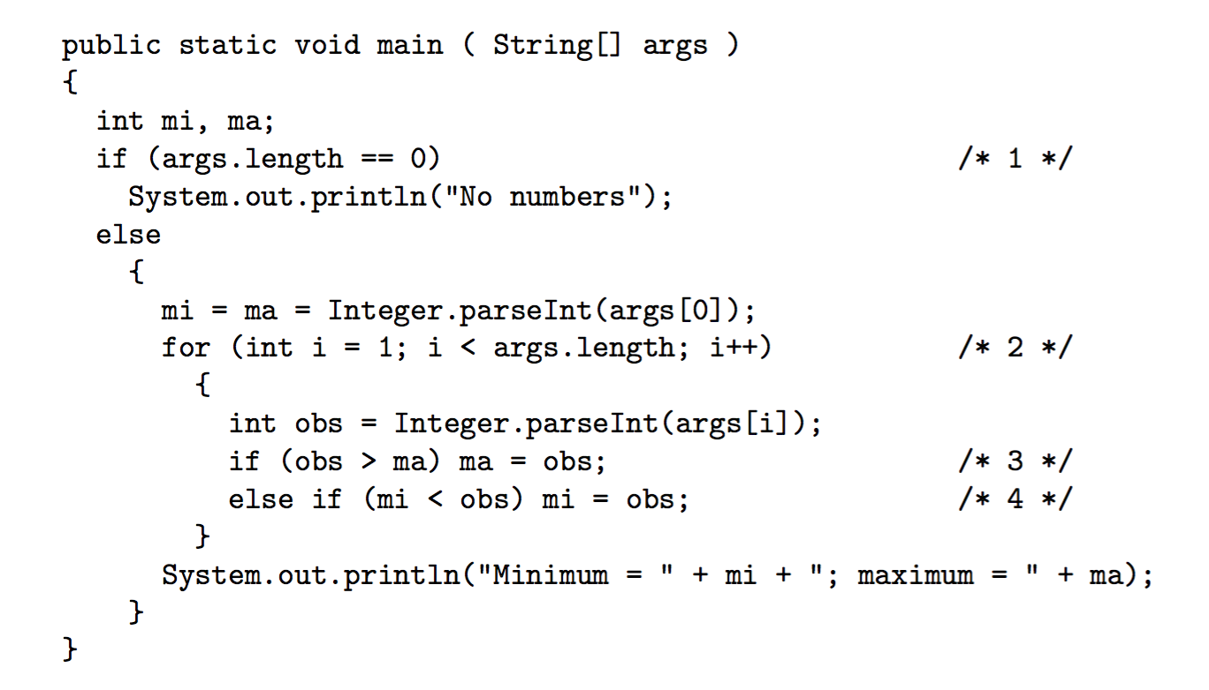
Whitebox (Peter Sestoft Example 2.1)

Slide 19
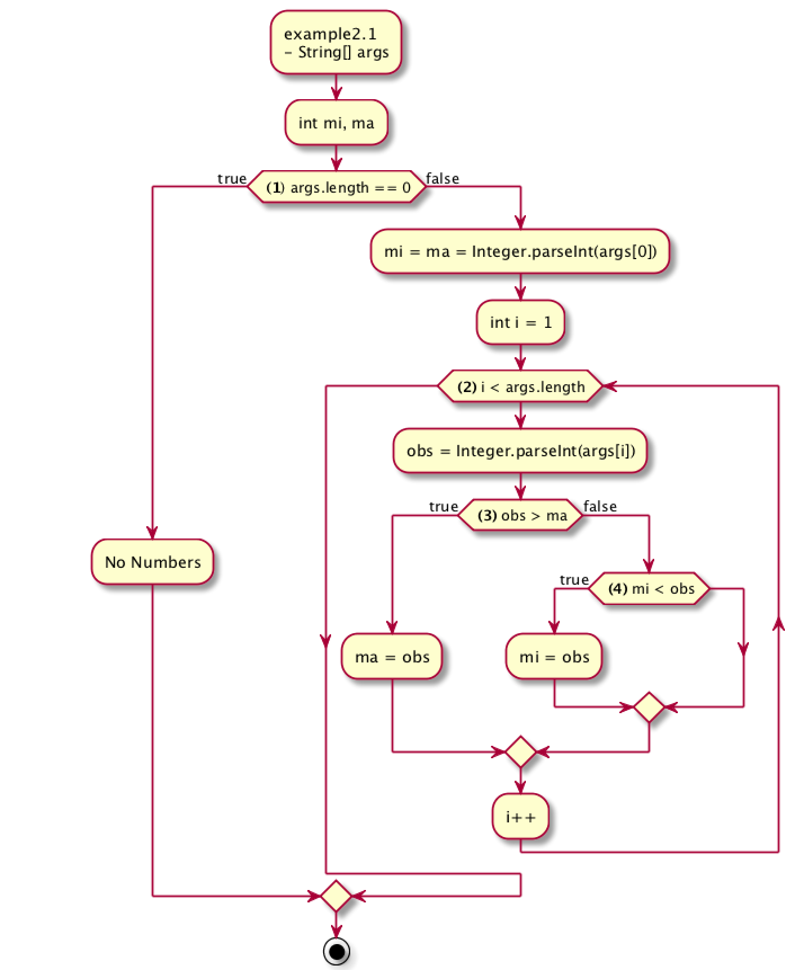
Example 2.1

Slide 20
Whitebox testing: constructing test cases
The resulting test suite includes enough input data sets to make sure that:
all methods have been called,
that both the true and false branches have been executed in if statements,
that every loop has been executed zero, one, and more times – why is “more times” important?
that all branches of every switch statement have been executed.
For every input data set, the expected output must be specified also.
Notes:
The “more times” is important because there is a risk that we have not established the invariant inside the loop, and therefore that the loop will not run correctly the next time around.
Or, explained without invariants. If we only check zero and one time, we only check if the program can continue correctly after the loop, not if we can enter the loop correctly again.

Slide 21
Test coverage
In practice white box testing is done on
Algorithms
To analyze for security holes
Normally one uses automated test coverage tools:
Measures to which extend our code has been tested
Integrated into Netbeans – colors your code red, green, yellow
It is pragmatic and “good enough”.

